Slide 1
King County Housing Data and Insights of customer services
Group 5
Niklas & Jan

Slide 2
Table of contents
The client
Dataset
Data cleaning
Hypothesis
Recommendation

Slide 3
Nicole Johnson
Stakeholder: Buyer
Lively and central neighborhood
Mid price range
Buy within a year

Slide 4
Dataset
King country house data for Seattle
Two tables
King country house details
Contains 19 columns like number of bathrooms, bedrooms and square meters as well as the quality of view
Raw data: 21420 rows
King country house sales
Contains the four columns id, house id, price and date
Raw data: 21597 rows

Slide 5
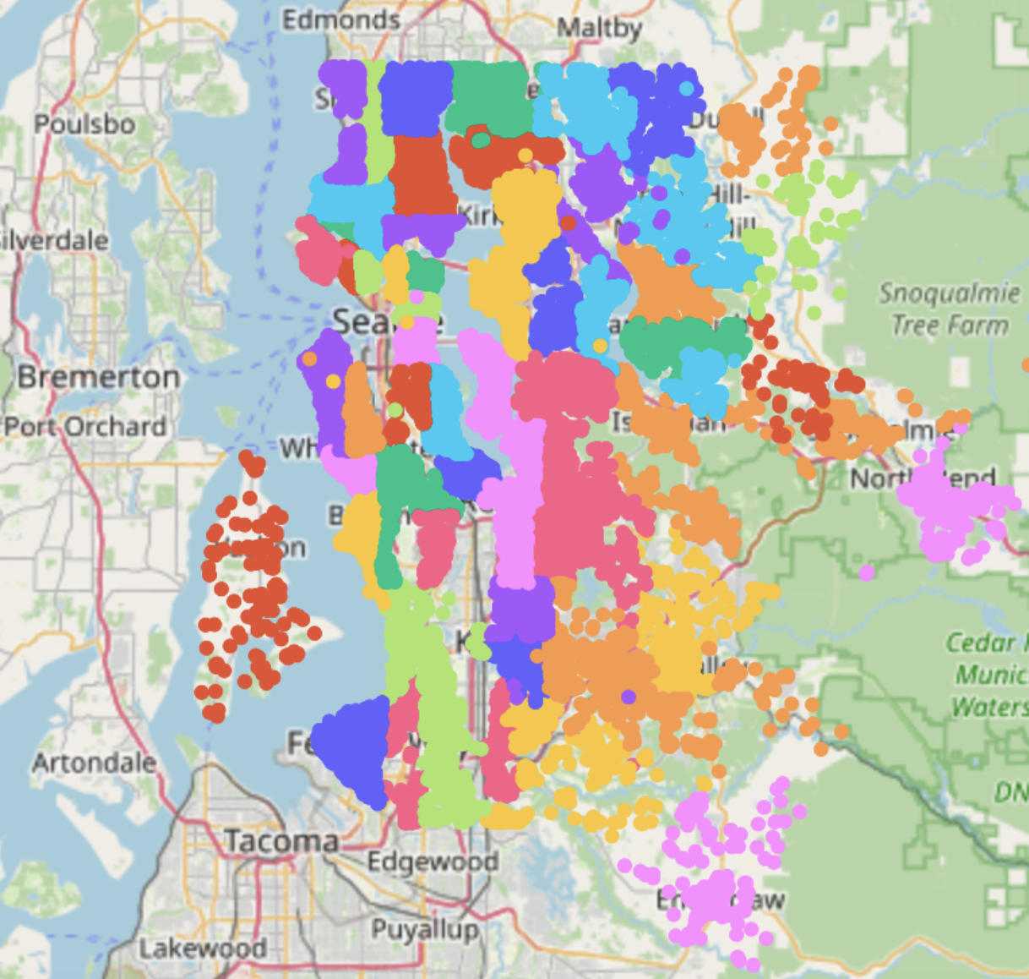
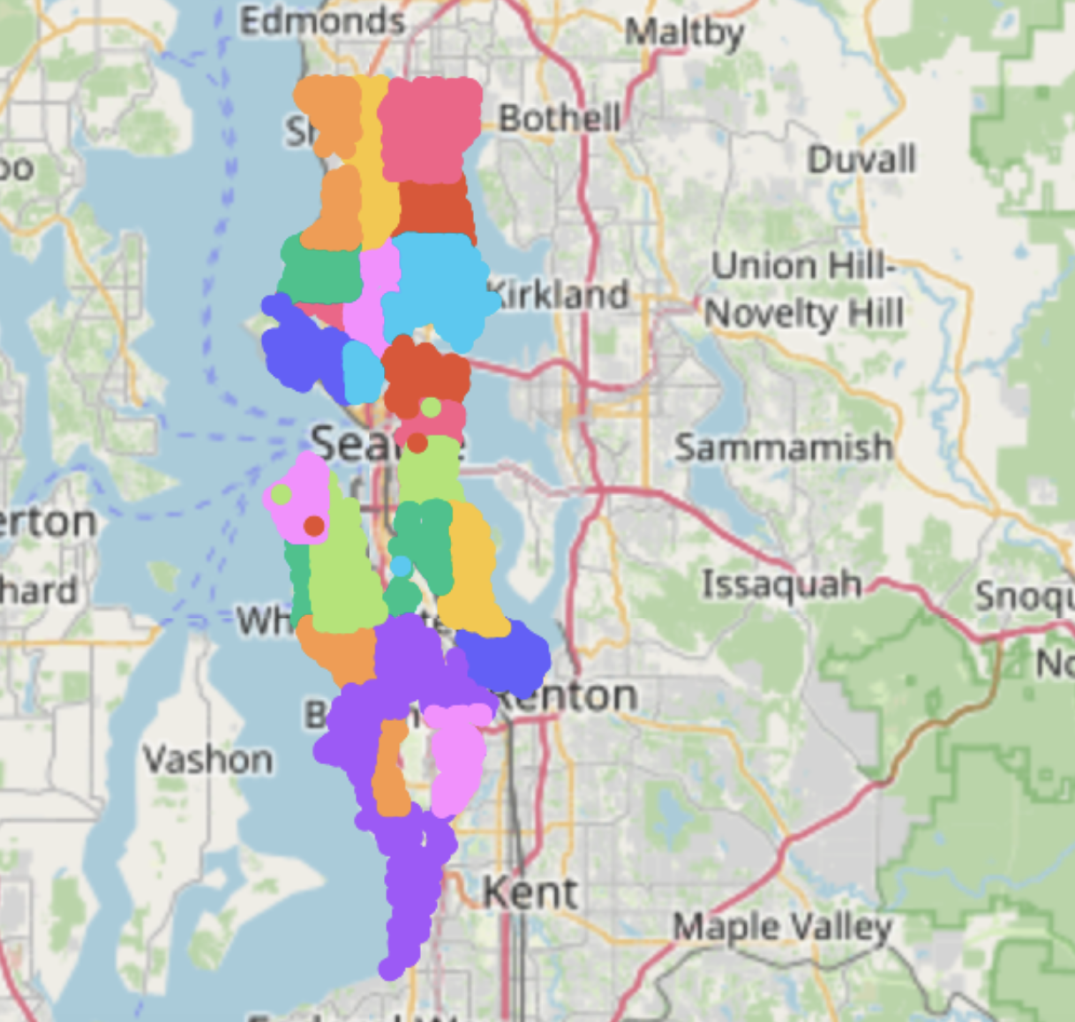
Data cleaning
Filtering the central neighborhood by zip code

Slide 6
Hypothesis
Hypothesis 1:
The more square feet and/or square lot the location has the higher the price.
Hypothesis 2:
There is at least one variable which has a bigger impact on the price than the others.
Hypothesis 3:
The price for a house is lower in the first half of a year.

Slide 7
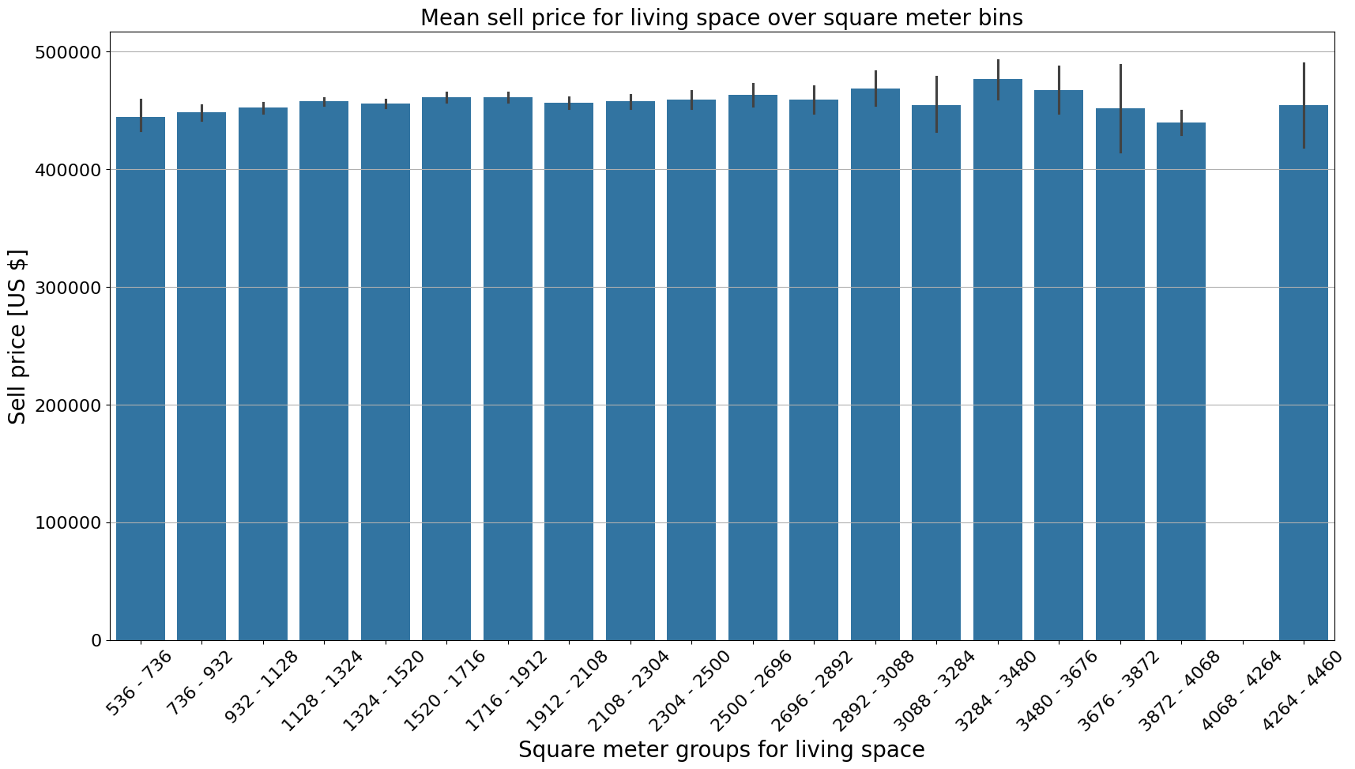
Hypothesis
Hypothesis 1: The more square feet and/or square lot the location has the higher the price.

Slide 8
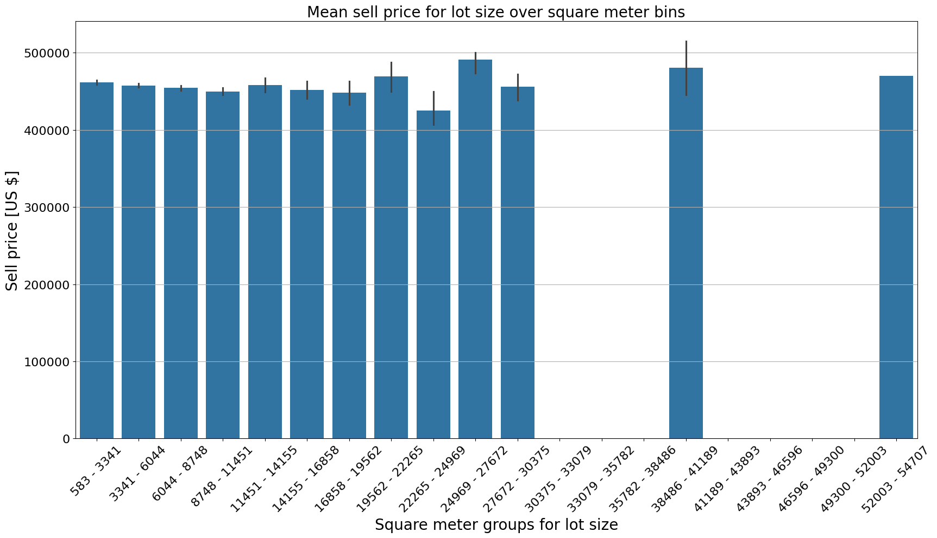
Hypothesis
Hypothesis 1: The more square feet and/or square lot the location has the higher the price.

Slide 9
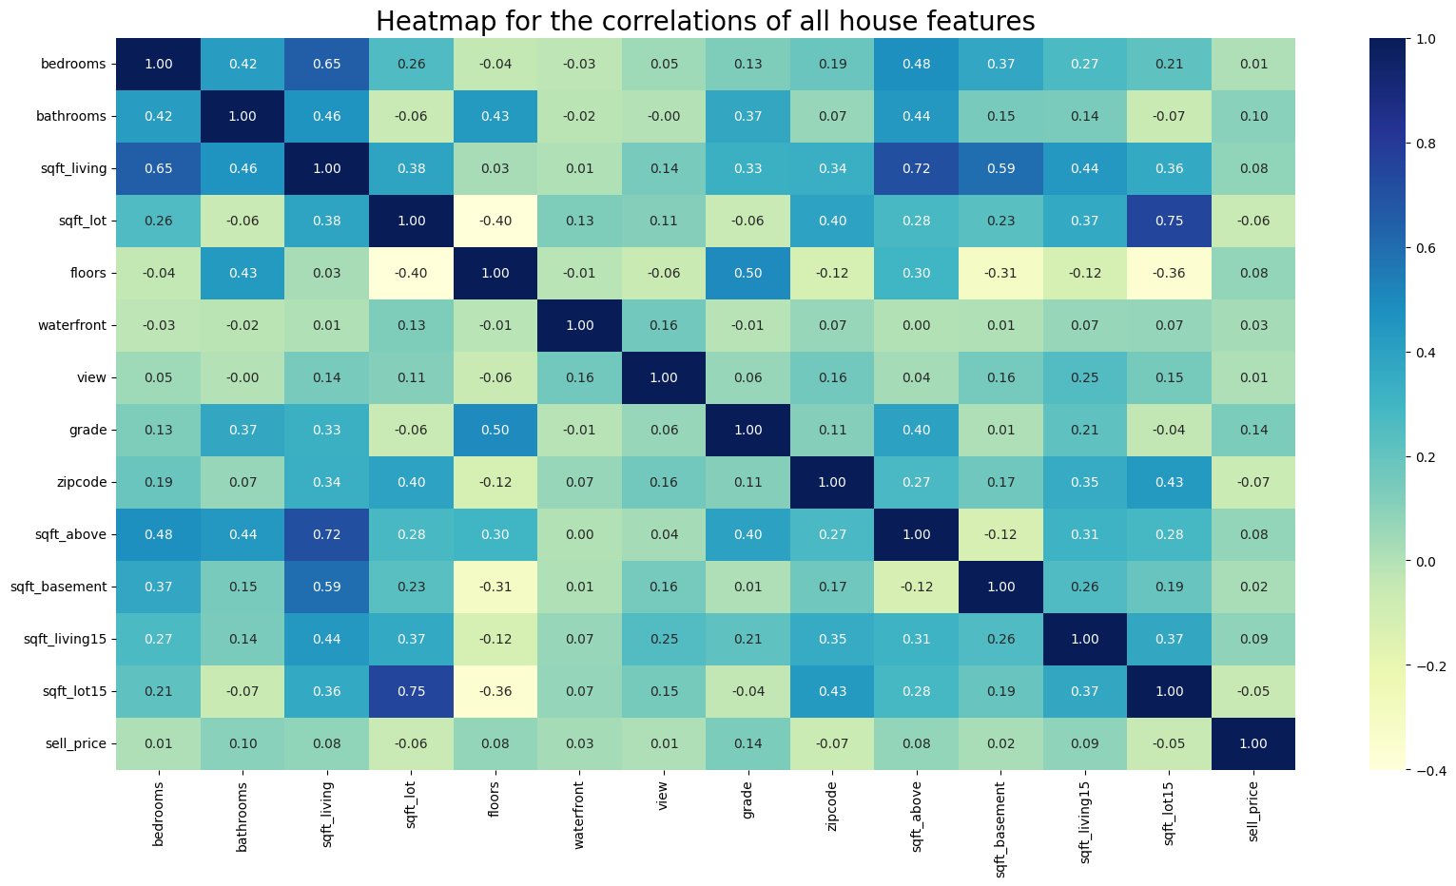
Hypothesis
Hypothesis 2: There is at least one variable which has a bigger impact on the price than the others.

Slide 10
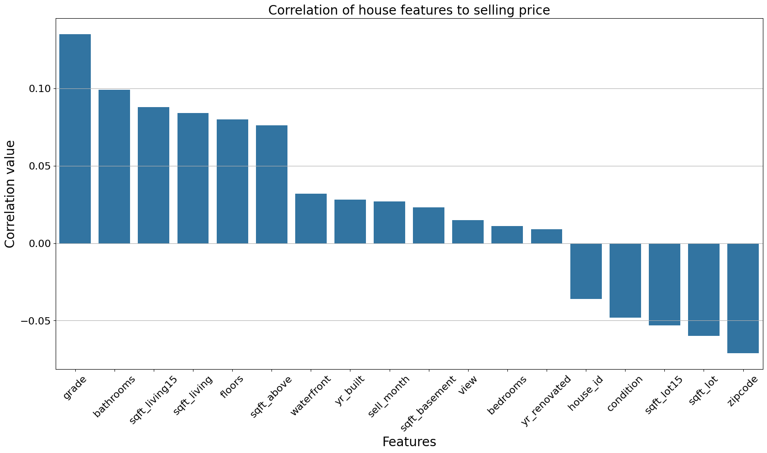
Hypothesis
Hypothesis 2: There is at least one variable which has a bigger impact on the price than the others.

Slide 11
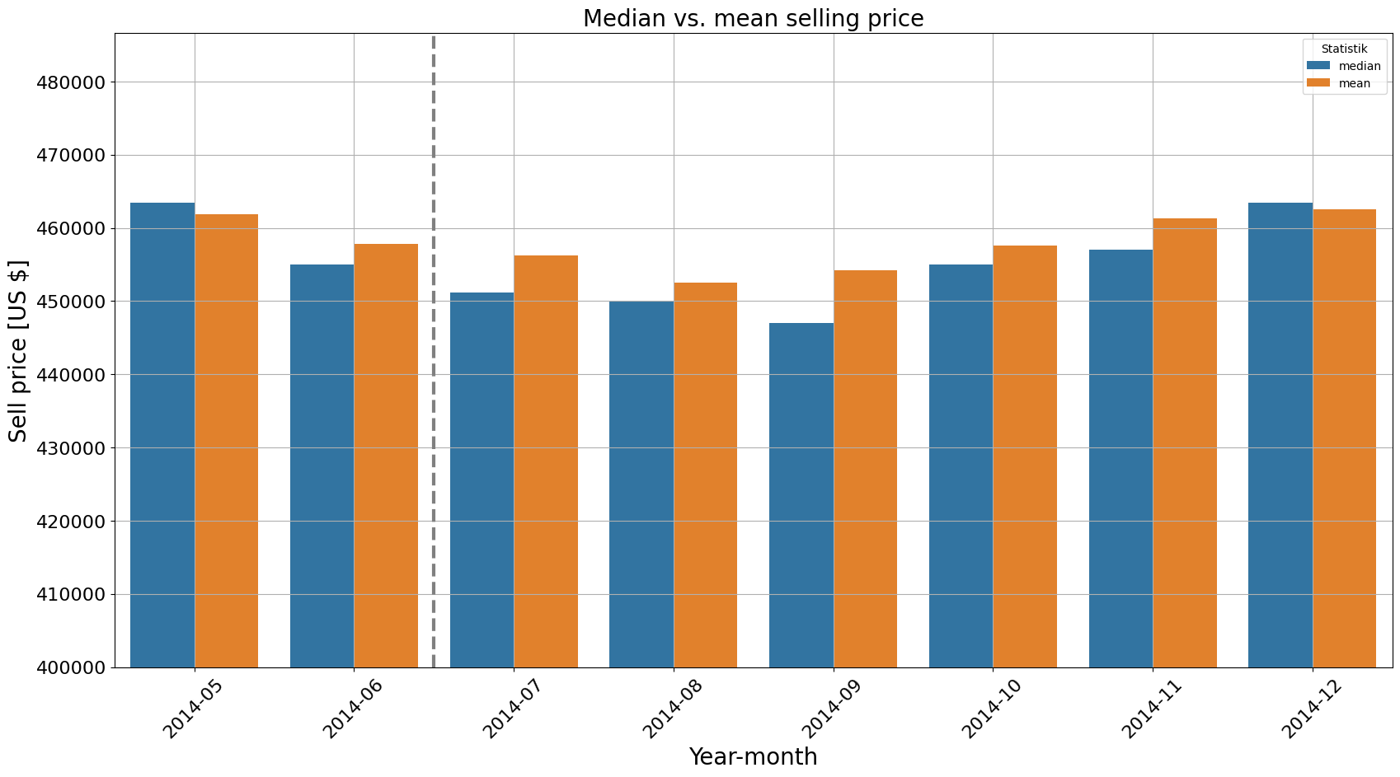
Hypothesis
Hypothesis 3: The price for a house is lower in the first half of a year

Slide 12
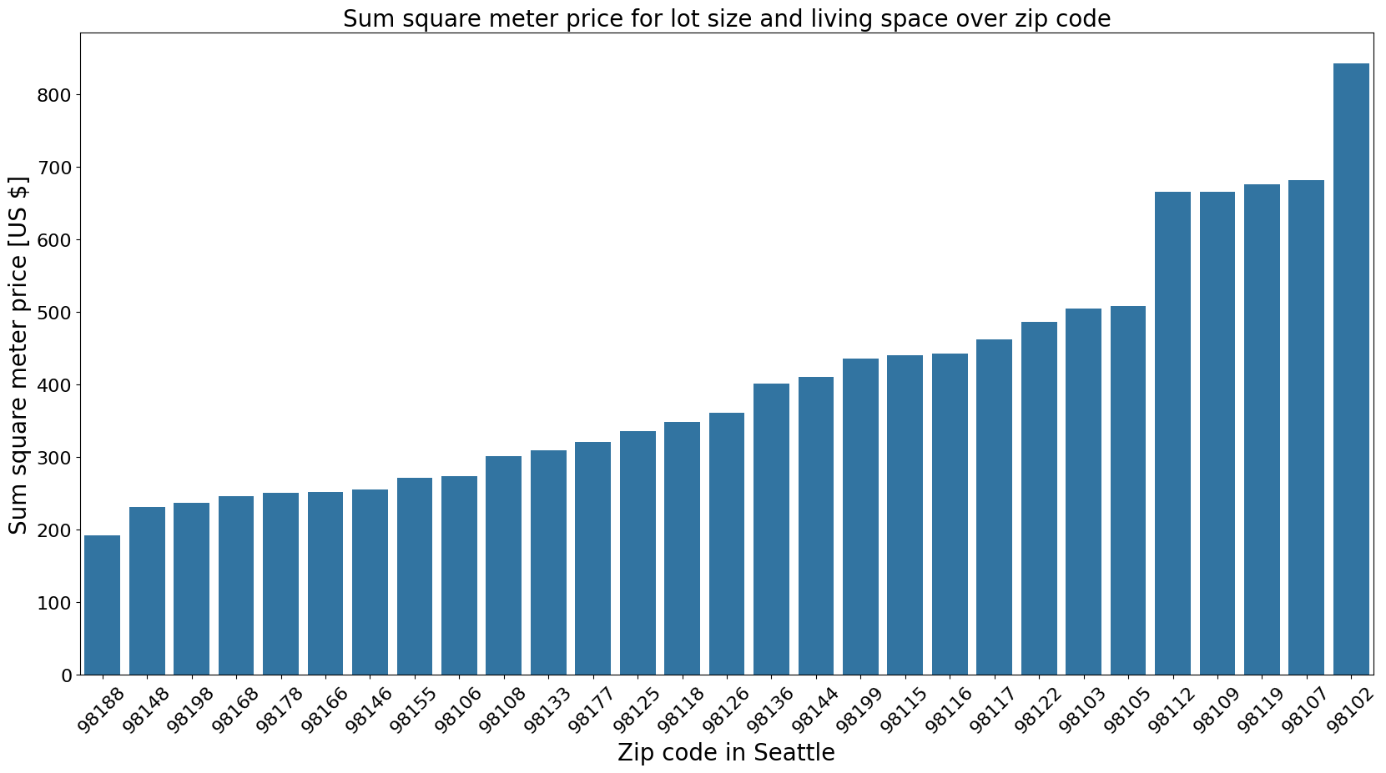
Recommendation
Hypothesis 3: The price for a house is lower in the first half of a year
98188 is the cheapest zip code in Seattle

Slide 13
Thanks for your attention
We wish Nicole all the best …

